Slide 1
Predicting Flight Prices With Machine Learning
By: Alexandra Huang, Travis Tornquist, Turner Edwards, Nicholas Stapp, and Max Riczo

Slide 2
The Data
The data set our group worked on was found on Kaggle
The data was pulled originally from Expedia between 2022-04-16 and 2022-10-05.
Our analysis only uses part of the whole data set for sake of time and computing power
With over 30 gigabytes of data in this set it provides ample training data

Slide 3
Reasons for Selecting this Data
The data set was very complete and gives us plenty of data to work with
The data gives many variables that will help the strength of the machine learning model
The results of our analysis could prove valuable to customers and airlines alike

Slide 4
Main Questions
What would a trip cost given certain variables?
Starting City
Destination
Departure Date
Return Date
Which of these variables impacts price the most or least?

Slide 5
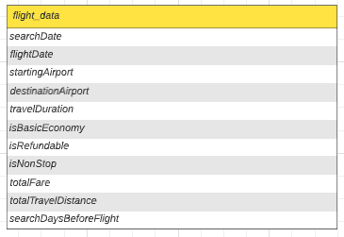
Exploring the Data
Figuring out the best machine learning model
Cleaning data for the machine learning model
Finding the most relevant columns

Slide 6
Languages Used
Python with Jupyter Notebook
Numpy
Pandas
Scikit-learn
Matplotlib
SQL with pgAdmin

Slide 7
Technologies Used
Kaggle for data set
Tableau for visualization
Linear Regression, RandomForest, (Gradient Boosting Regression) machine learning models

Slide 8

First Analysis
Creating new columns from the original data to use with the machine learning model
Converting and encoding data for the machine learning model
Two machine learning models used: Linear Regression and Random Forest

Slide 9
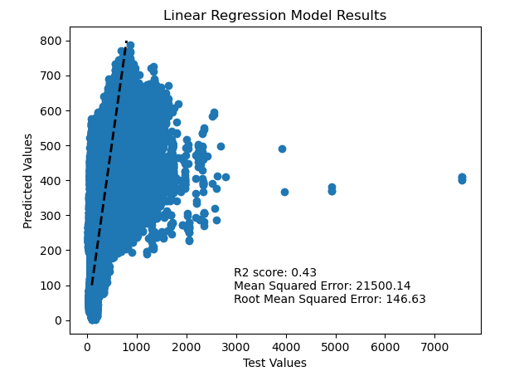
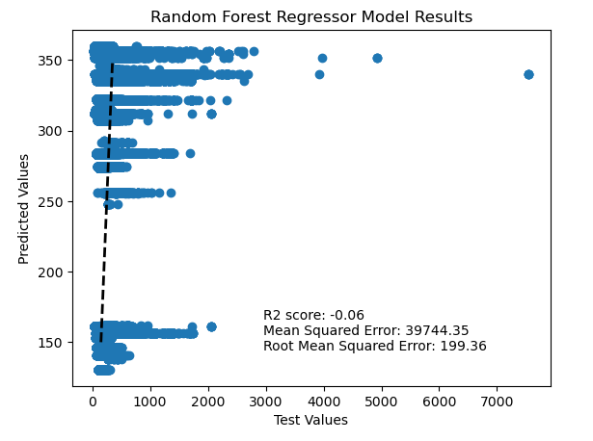
First Analysis Results
Notes:
Notes: Only used part of the total data set for

Slide 10
Revisions to the Model and Data
Scaled data using StandardScaler from scikit-learn
Added another machine learning model: Gradient Boosting Regression

Slide 11
Second Analysis Results

Slide 12
Main Challenges

Slide 13
What We Would Do Differently
Breaking down the data into buckets for better classification

Slide 14
Final Findings

Slide 15
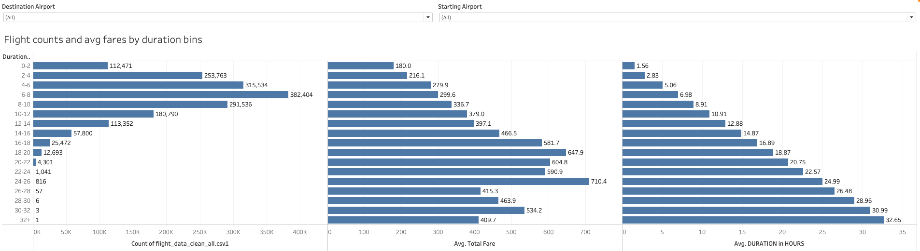

Slide 16
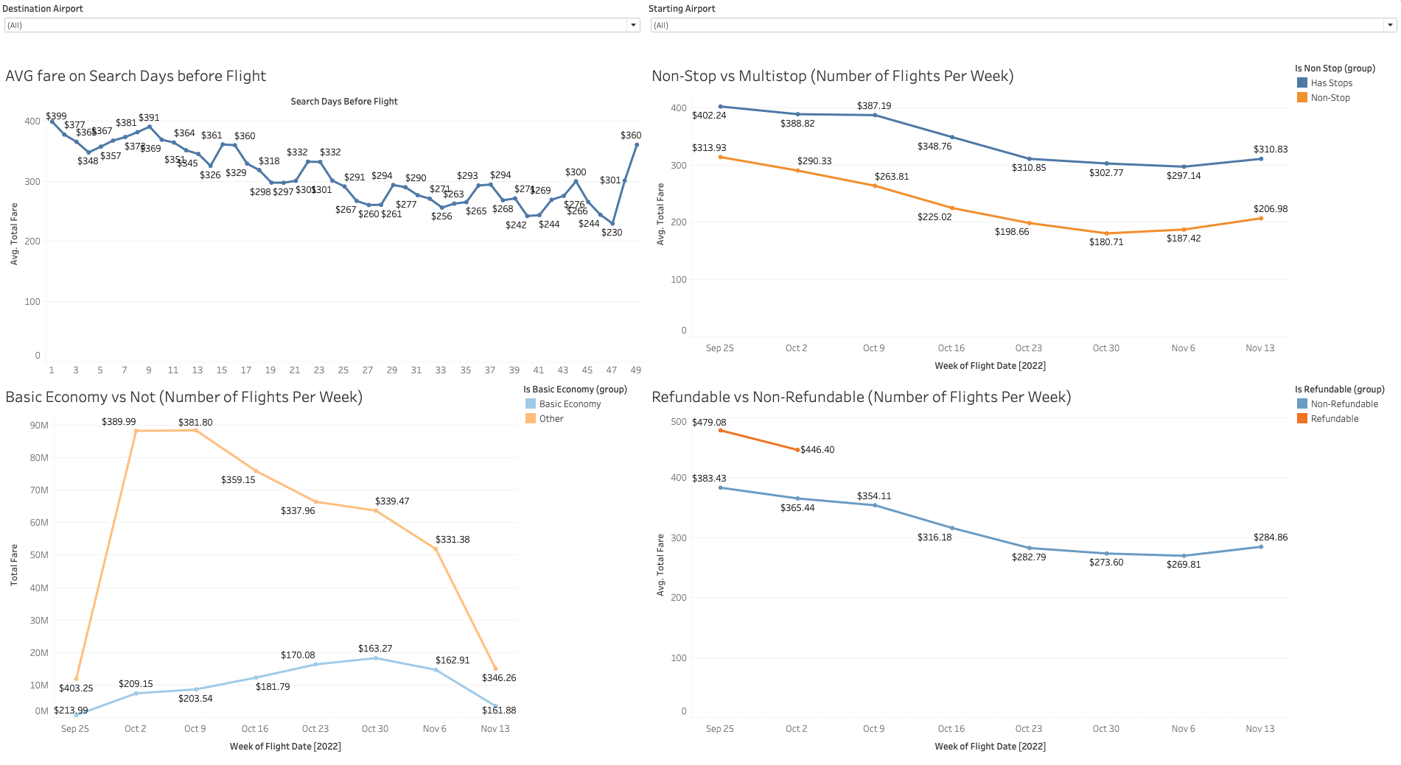

Slide 17
